Slide 1
Git Step 2

Slide 2
Git
Git is an open-source distributed version control system.
Git is the most commonly used version control system.
Git tracks the changes you make to files, so you have a record of what has been done, and you can revert to specific versions should you ever need to.

Slide 3
Git Repositories
A Git repository (or repo for short) contains all of the project files and the entire revision history.
You’ll take an ordinary folder of files (such as a website’s root folder), and tell Git to make it a repository.
This creates a .git subfolder, which contains all of the Git metadata for tracking changes.

Slide 4
Steps to create the Project structure and push to remote repositories.
Create a folder with name : Running Capstone Project - Banking Application
Then create four folder with name phase1, phase 2, phase 3 and phase 4
Please make sure install git present in local machine or virtual lab.
Then open the git terminal inside that folder.
Then follow step to make the local folder as local repository.

Slide 5
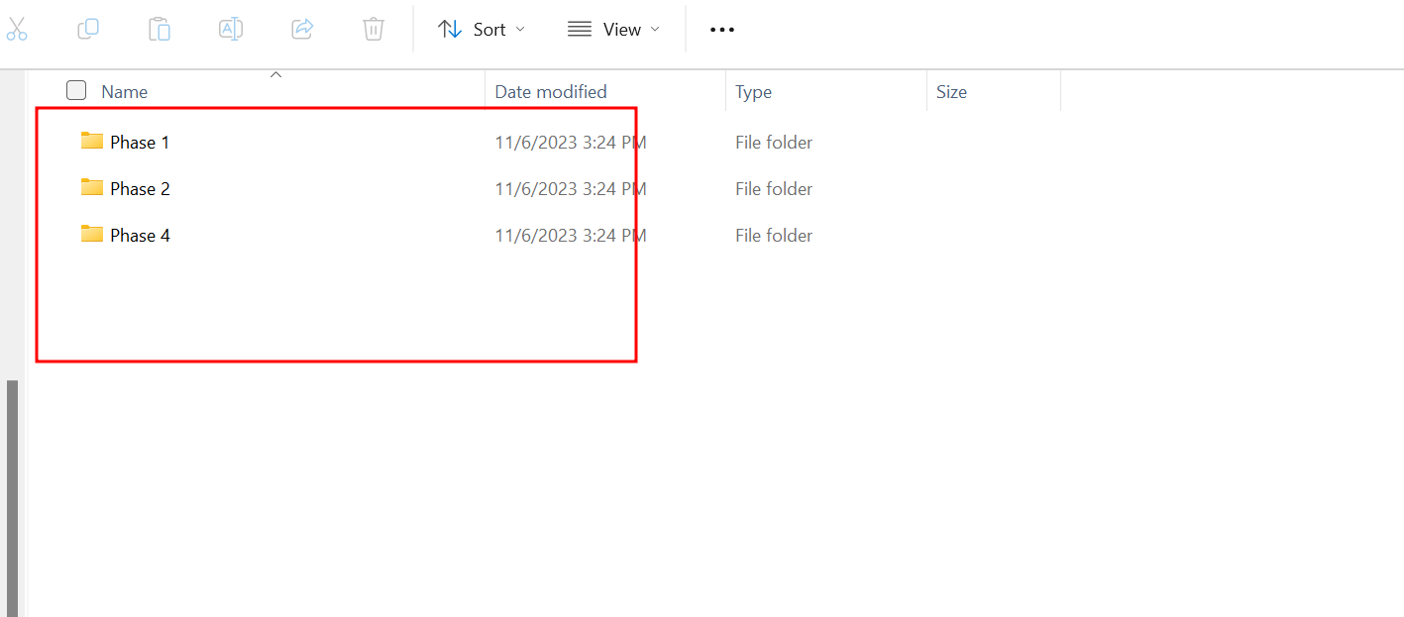
Git steps

Slide 6
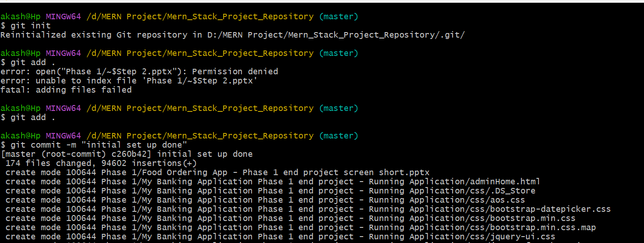
Git steps to create local repository
git init
git add .
git commit –m “project structure ready”

Slide 7
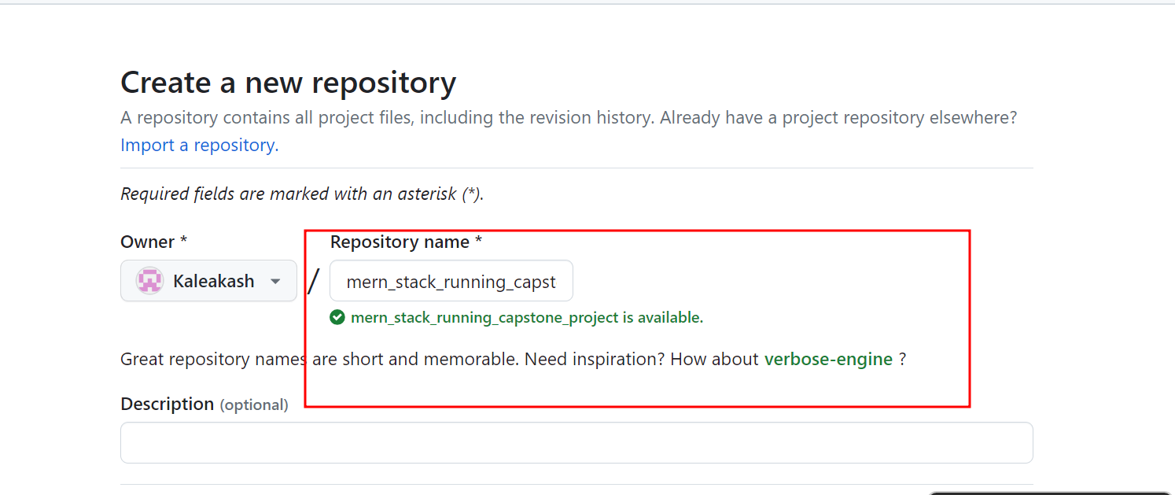
Now we will create remote repository

Slide 8
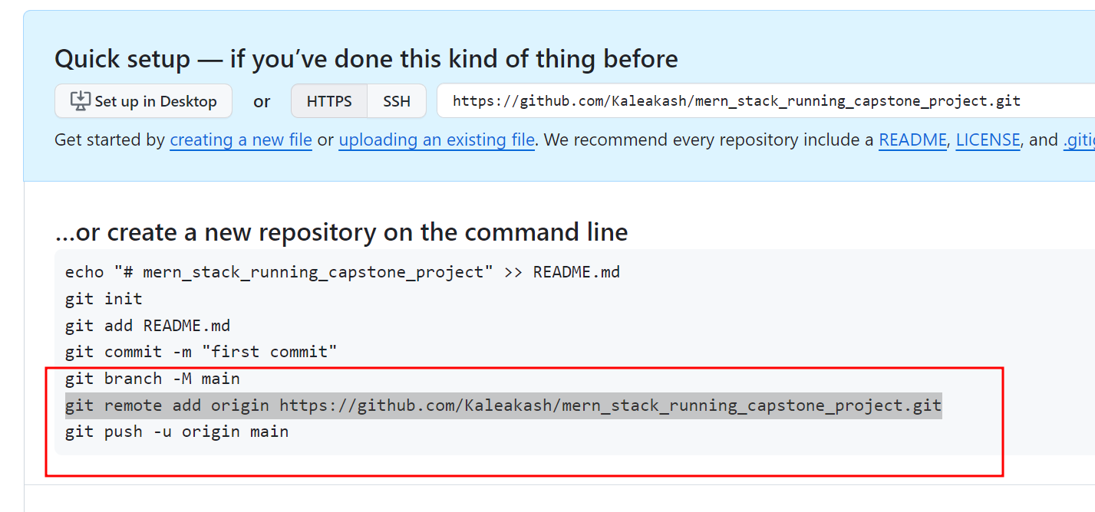
Connecting to local to remote repository

Slide 9
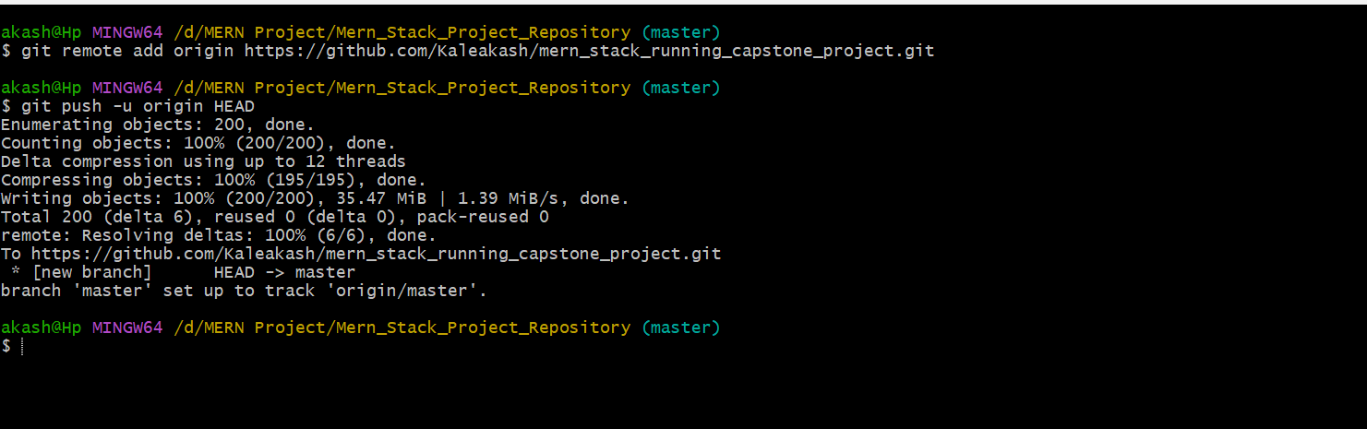
Command connecting local to remote

Slide 10
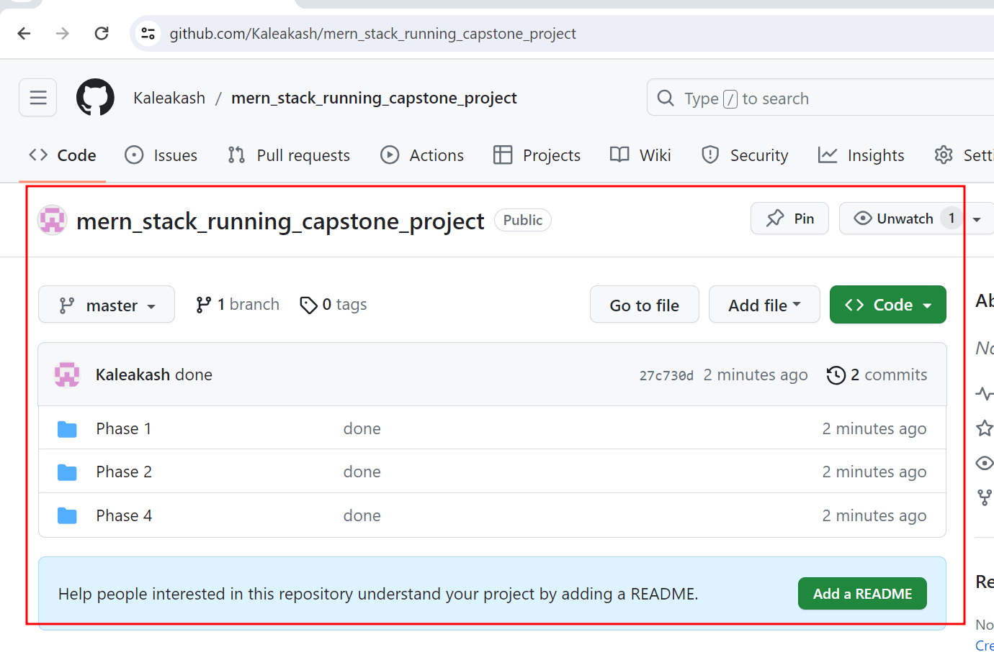
Remote git project structure uploaded

Slide 11
Remote repository url is
https://github.com/Kaleakash/mern_stack_running_capstone_project.git

Slide 12
End of the git we expect
End of this module participants must be created git local repositories.
Must be created project structure for all the phases.
This create account in git remote repository and link local repository to remote repository.
Create readme file with and all phases folder contains text file.
This push this code to remote repository

